Slide 1
Software Testing & Quality Assurance
CSCI 671
Apeksha Fule
Bindu Priya Chowdarapu
Gagana Aladhalli Ramegowda
Yaswanth Raj

Slide 2
GUI Implementation

Slide 3
Flask
Flask is an open-source web development framework for building web applications in Python.
It is lightweight and flexible, making it easy to build web applications quickly and easily.
Flask is designed to be easy to use and understand, making it an ideal choice for beginners and experienced developers alike. Flask is usable with python

Slide 4
WHAT WE HAVE USED
Python
HTML
CSS
Flask

Slide 5
Why Python
Easy to use
Libraries and frameworks
Portability
Why HTML & CSS
Easy to use
Structure
Portability

Slide 6
GUI
Welcome page

Slide 7
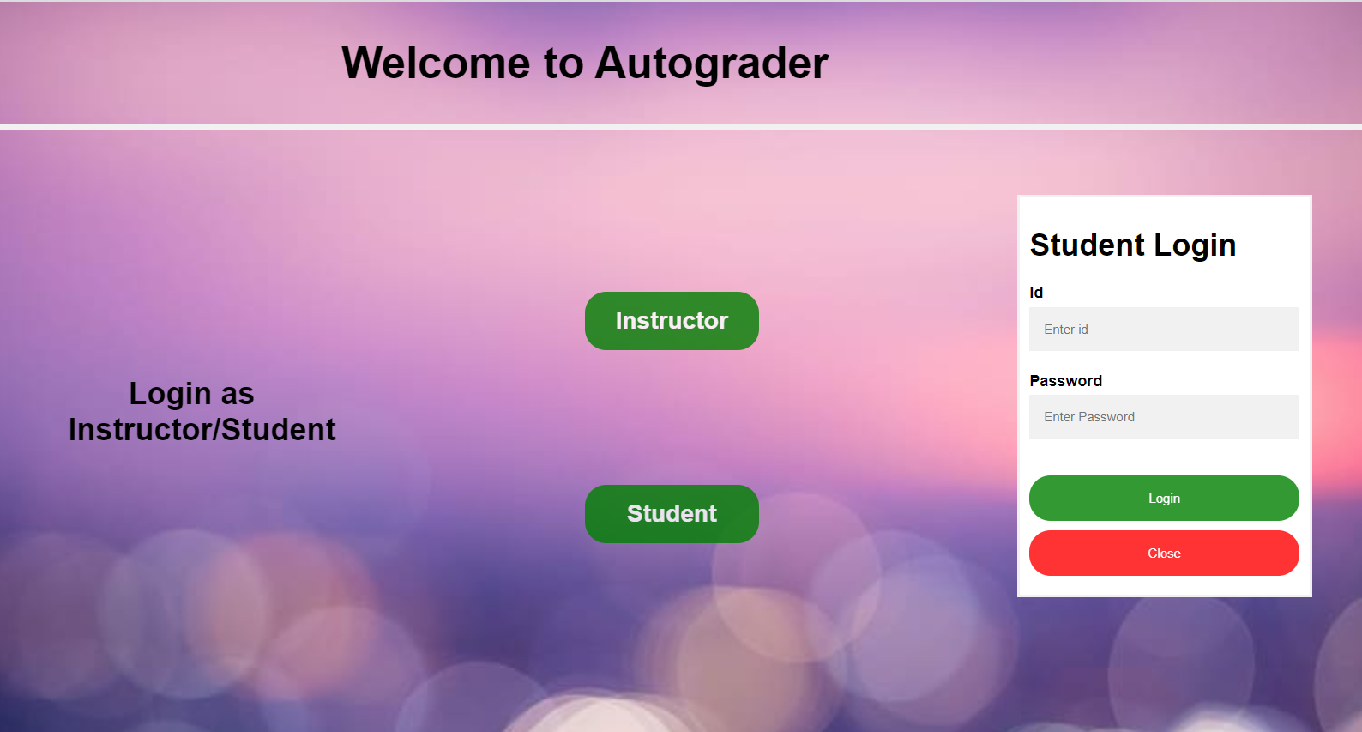
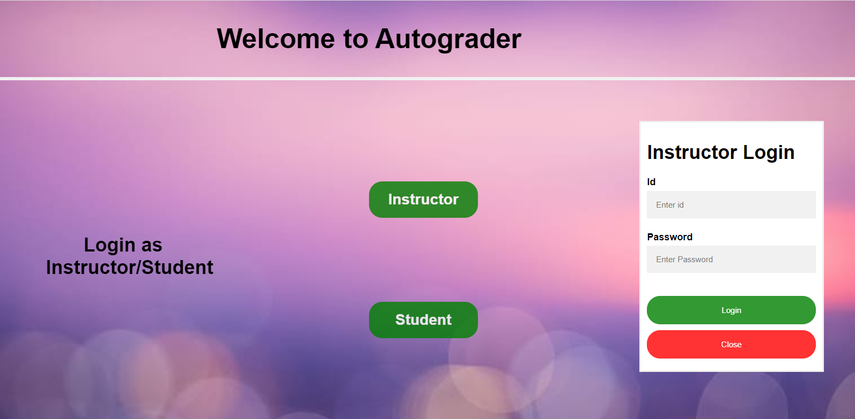
Login Screens
Student Login
Instructor Login

Slide 8
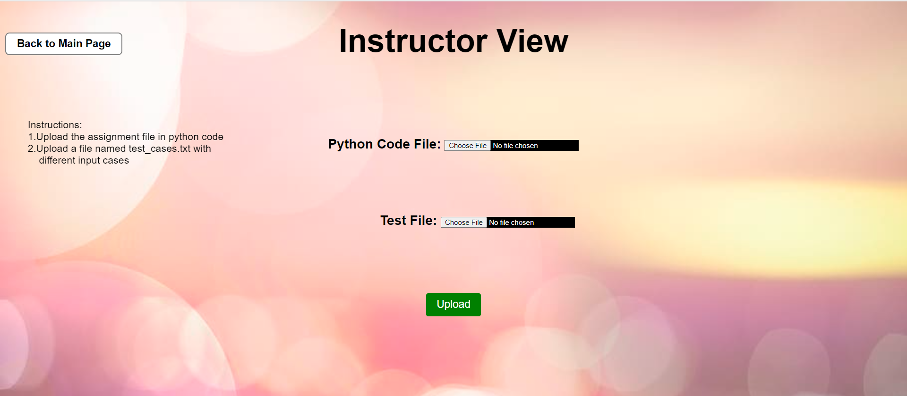
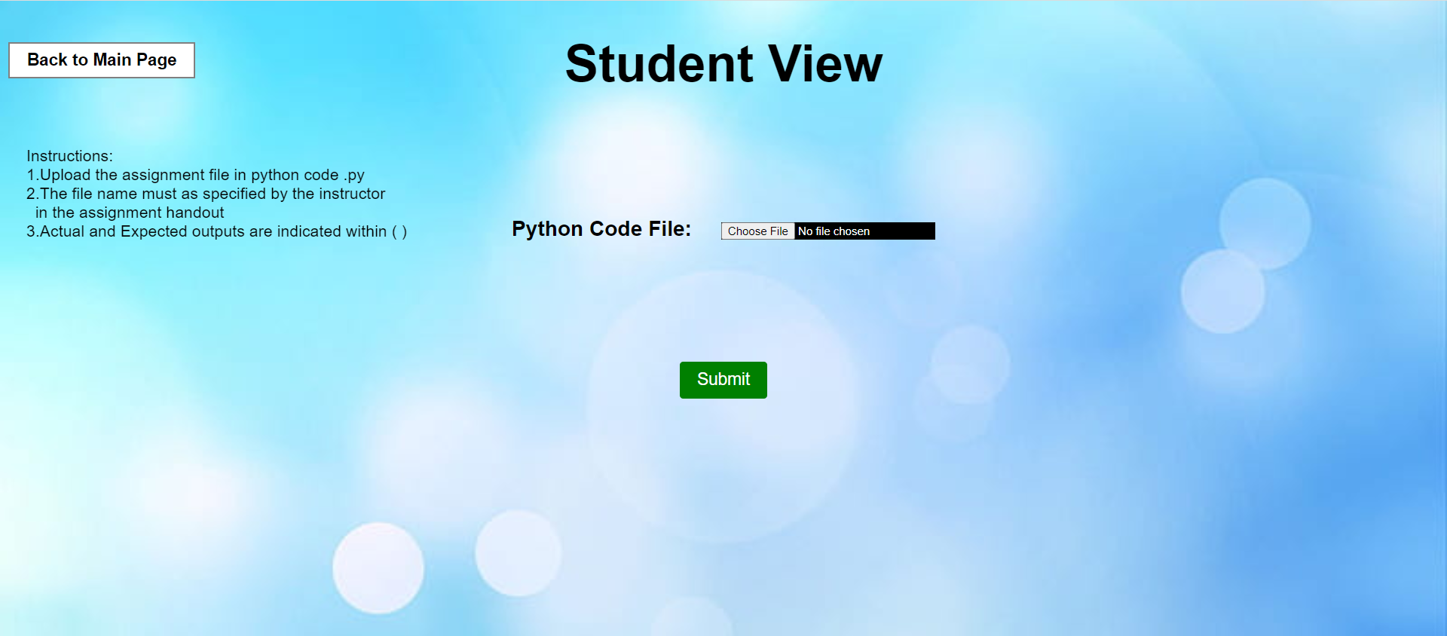
Instructor View
Student View

Slide 9
Code Implementation

Slide 10
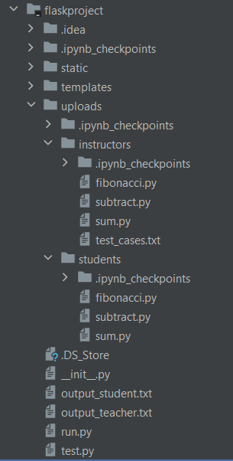
The files loaded from UI are placed in two separate folders (upload/students, uploads/Instructor)
Python scripts are used for code implementation
Subprocess command is used to run files that provides the result after running the file.
Check for any issue in the student code.

Slide 11
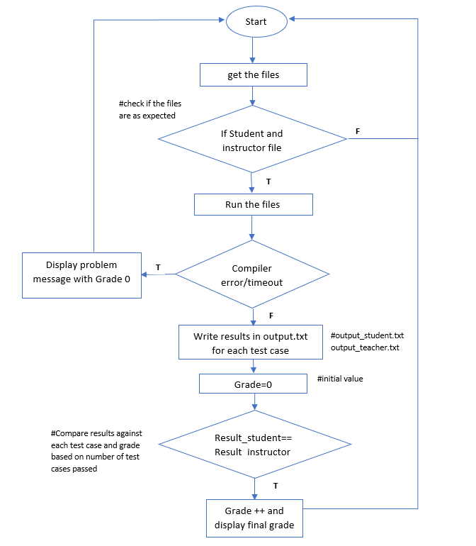
Flow chart
output_student.txt and output_teacher.txt is used for storing results
Results are compared for each testcases.
Graded based on the number of test cases passed.

Slide 12
TESTING

Slide 13
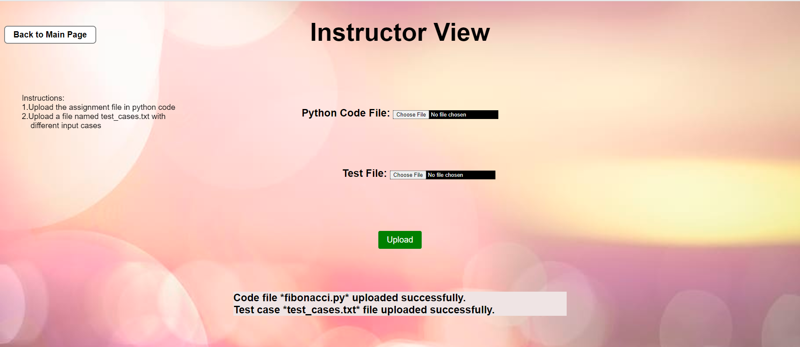
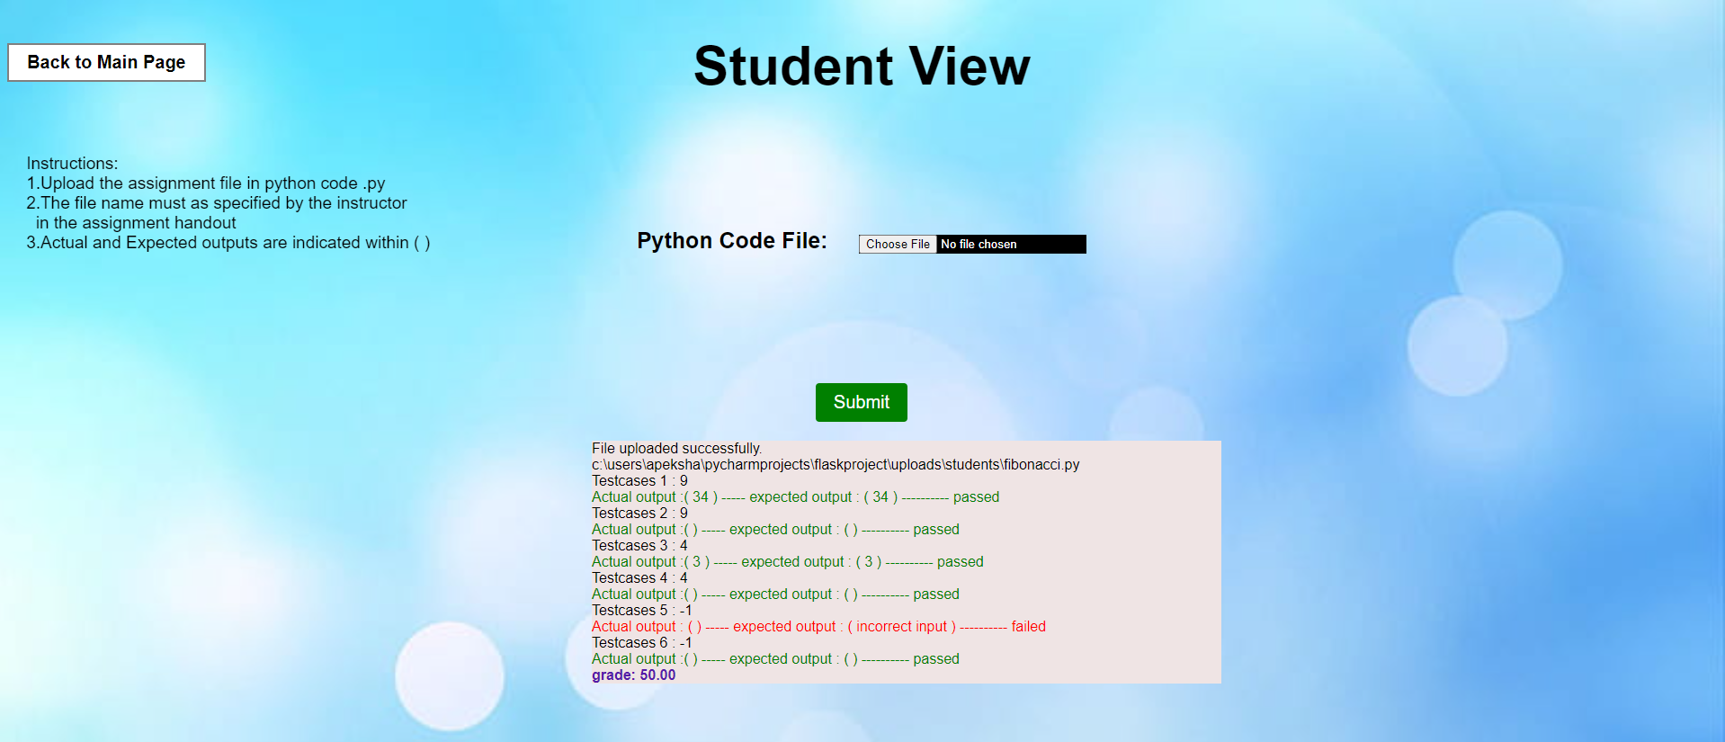
POSITIVE SCENARIO When student submit the assignment(.py file) and grades are displayed based on the number of test cases executed.
Instructor View
Student View

Slide 14
Instructor view When only one file or no file is uploaded in instructor view, a warning message is displayed.

Slide 15
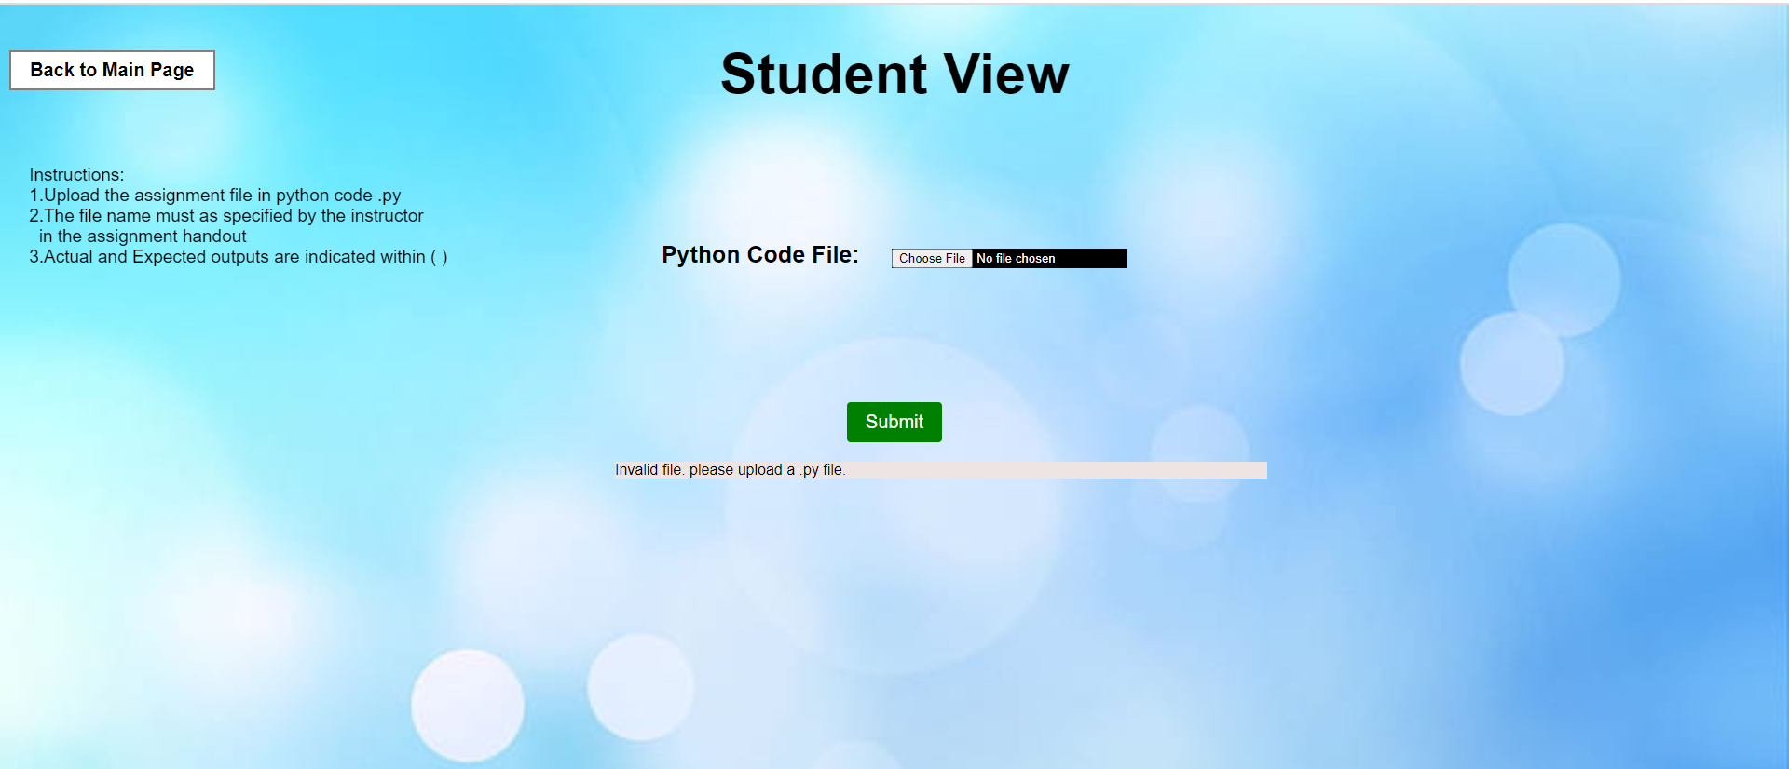
Student View When user submits an empty file or no file is submitted, a message is displayed.

Slide 16
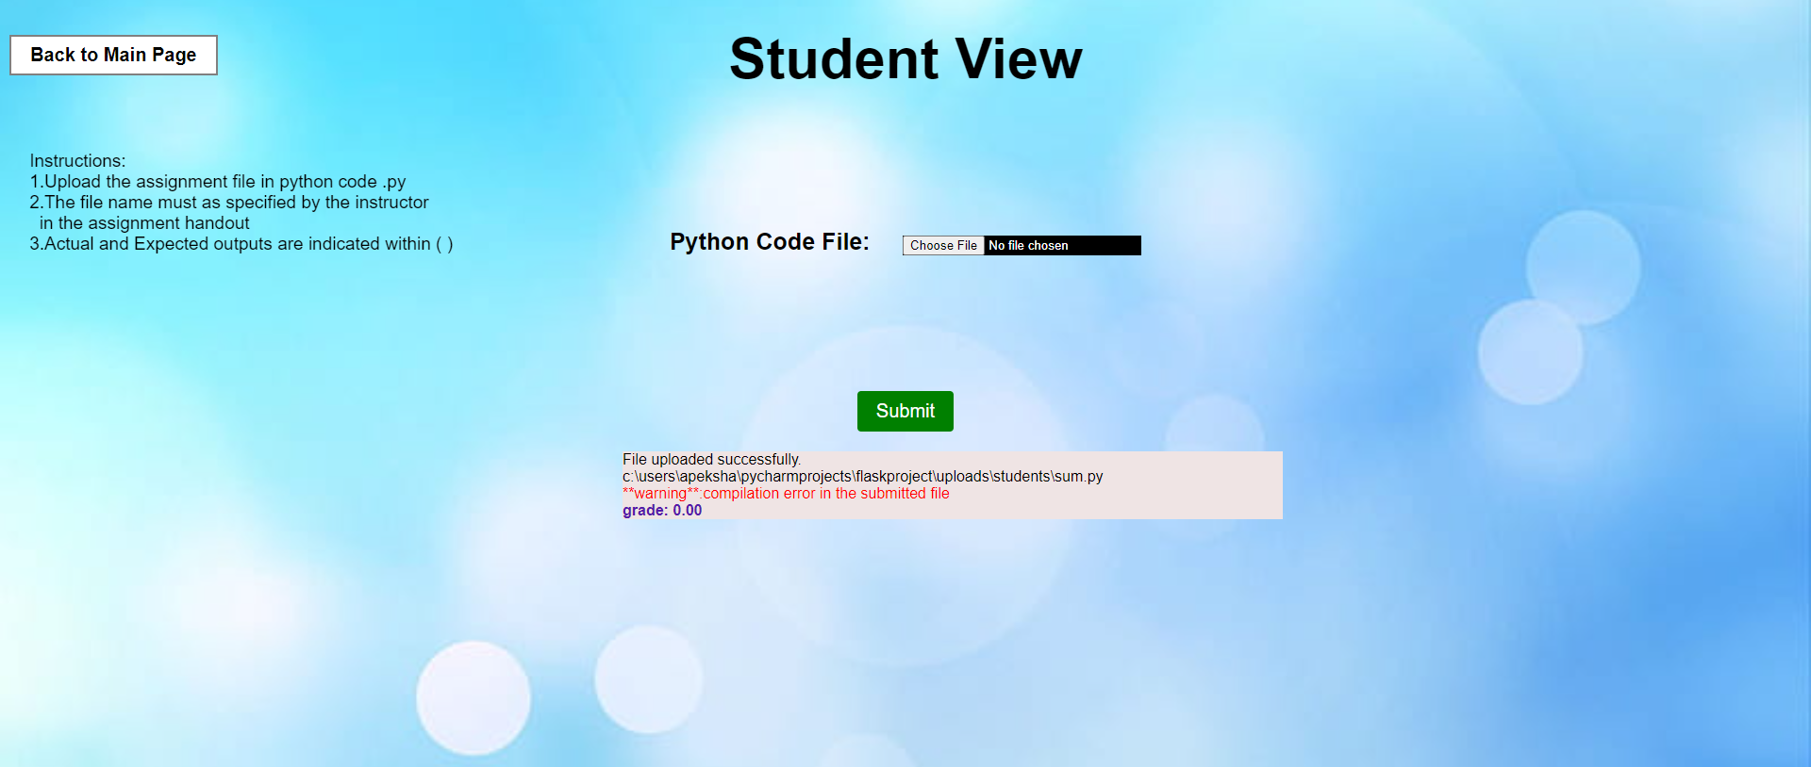
When student submit .py file and it contains compilation error.
Student get 0.00 grade and a compilation error message is displayed.

Slide 17
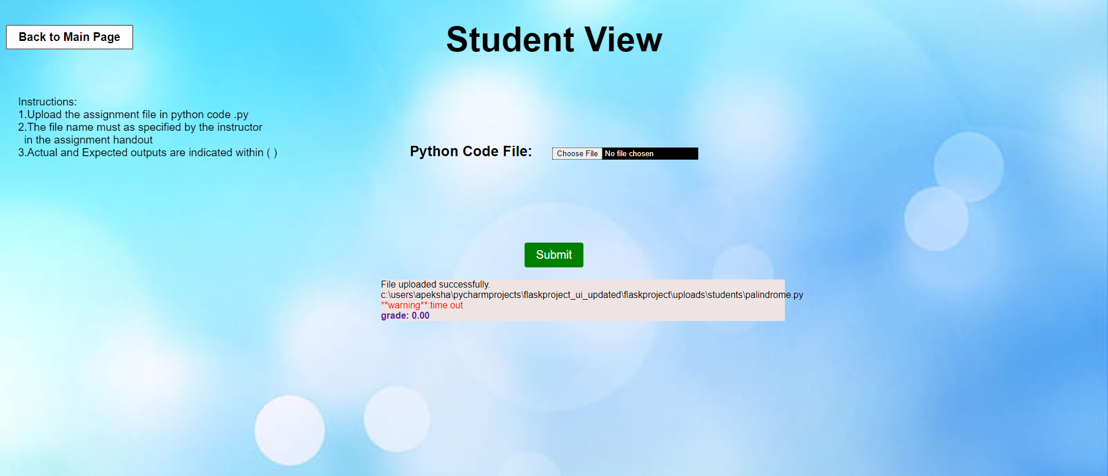
When student submits the .py file and timeout occurred.
Students get 0.00 grade and Time out warning message is displayed.

Slide 18
QUALITY METRICS

Slide 19
Reliability
It is the probability of the system to operate without any failure.
Compilation errors, infinite loops.
Performance
The ability to complete requested functions or services within the expected time span by the users.
How well it performs in terms of speed and the responsiveness.
Maintainability
The code can be updated easily for any changes

Slide 20
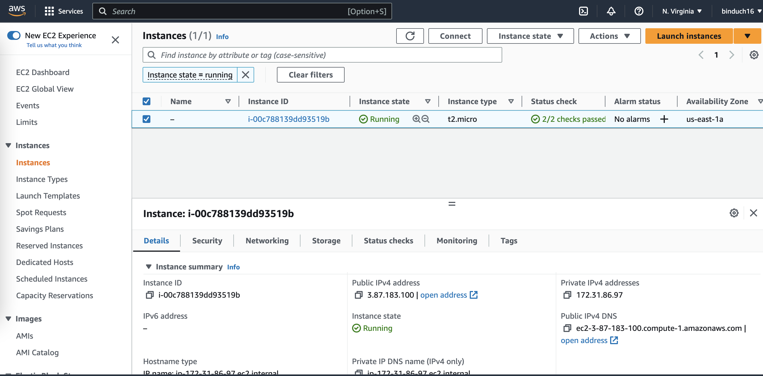
Availability
The fraction of time the system is available.
Deployed in AWS server, multiple users can access at a time using the public IP address.

Slide 21
THANK YOU

